Slide 1
Finding the Evidence
Roya Safari-Faramani
Epidemiologist (PhD)
KUMS 2019

Slide 2
Objectives
Formulate a focused question
Turn a focused question into a search
Search PubMed & Cochrane

Slide 3
question
Is Hormone Replacement Therapy (HRT) in post menopause women reduce the risk of femoral fracture?

Slide 4
PICO
P: Population
I: Intervention
C: Comparison group
O: Outcome
Time and Type of Study

Slide 5
PICO
Population Post menopause women
Intervention HRT
Comparison group no HRT
Outcome Femoral fracture risk

Slide 6
Search in PubMed
Look literally for the words entered
Using MeSh (Medical Subject Headings)

Slide 7
question
Is Hormone Replacement Therapy in post menopause women reduce the risk of femoral fracture?

Slide 8
PICO
Population post menopause women
Intervention HRT
Comparison group no HRT
Outcome Femoral fracture

Slide 9
Operators
  AND
  OR
  NOT

Slide 10



Logics
Shaded areas indicate retrieval | Search Statement | Types of records retrieved
 | stress AND anxiety | Documents that have either stress AND anxiety
 | stress OR anxiety | Documents that have both stress OR anxiety
 | stress NOT anxiety | Documents that have stress but NOT anxiety

Slide 11
PICO
Population post menopause women
AND
Intervention HRT
AND
Comparison group no HRT
AND
Outcome Femoral fracture

Slide 12
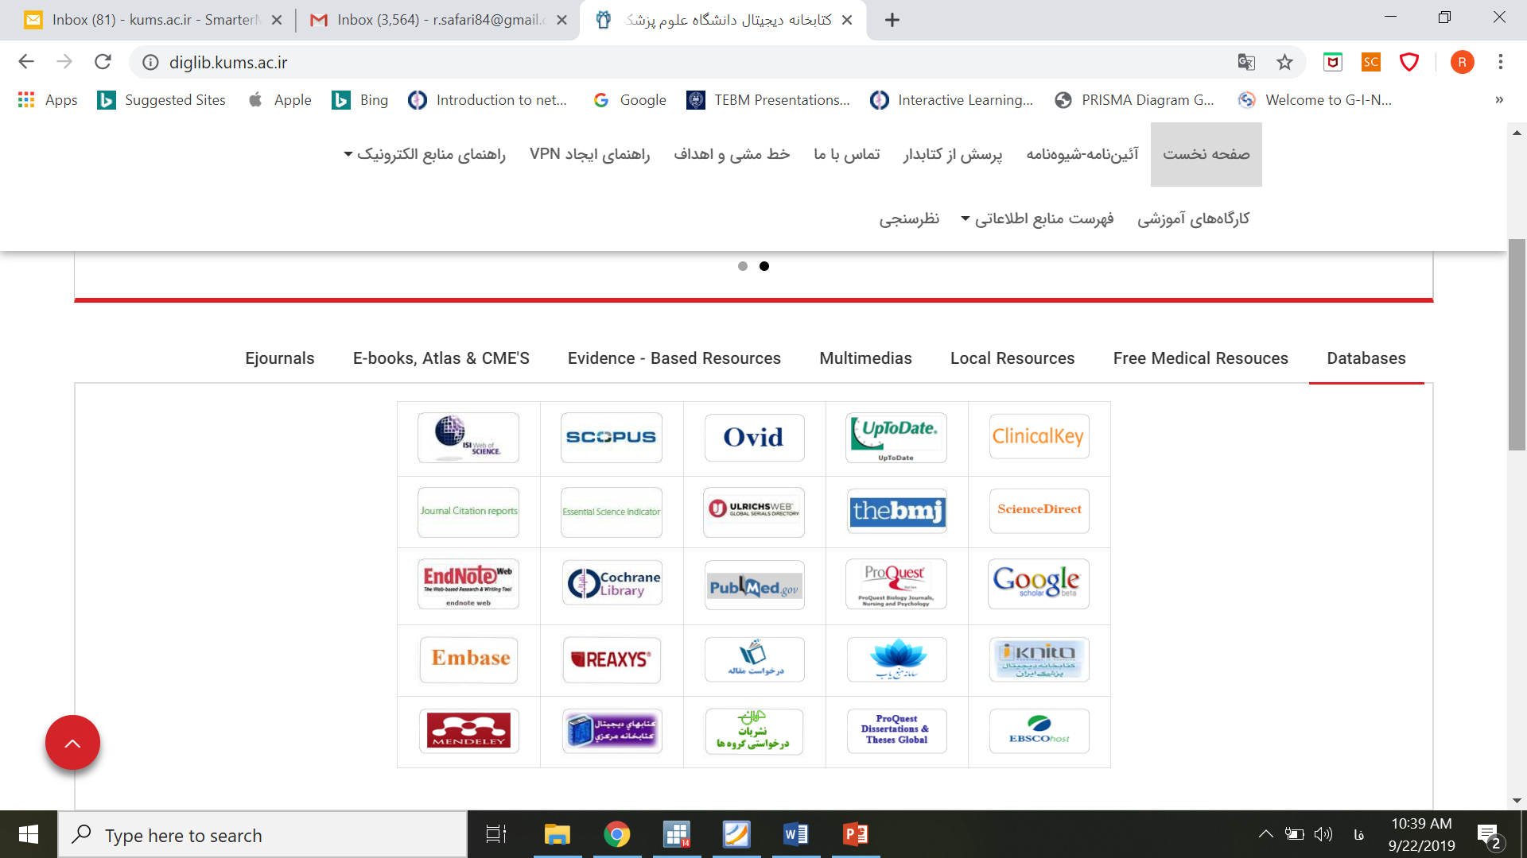
Start

